Slide 1
Banking Application
Presented By: Mounika, Suraj & Jaya Krishna.

Slide 2
Abstract
This project is about a bank application which is used to provide services to the customer for managing his bank account by using database CRUD operations where most of the privileges are controlled by Admin like creating account, withdraw & deposit etc. The customer is restricted to use only two features. They are transaction history & checking balance. This application can be able to provide services to the banks that has only one branch.

Slide 3
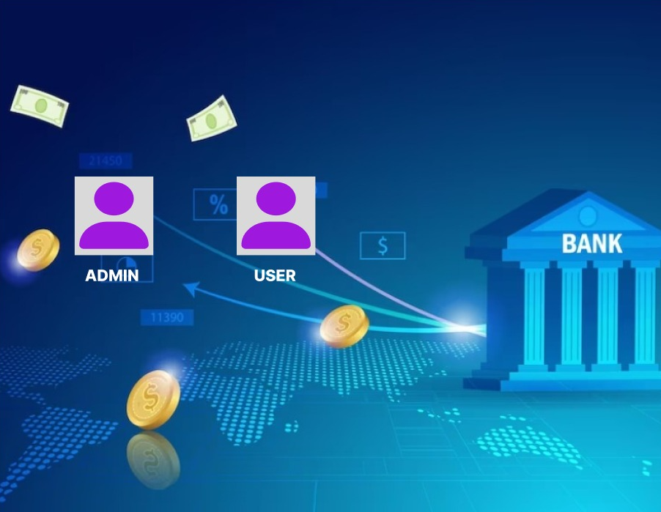
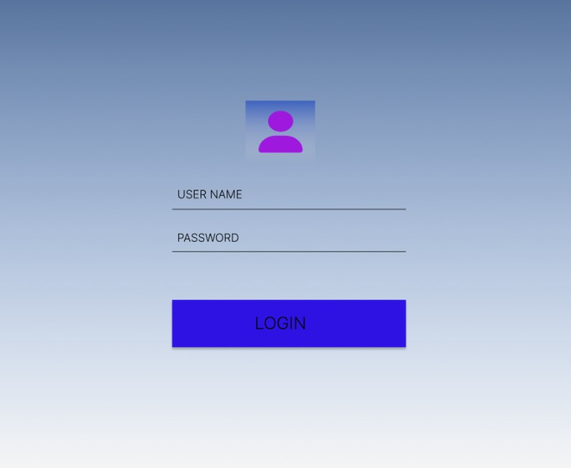
Presentation Layer – Admin &User Login Page

Slide 4
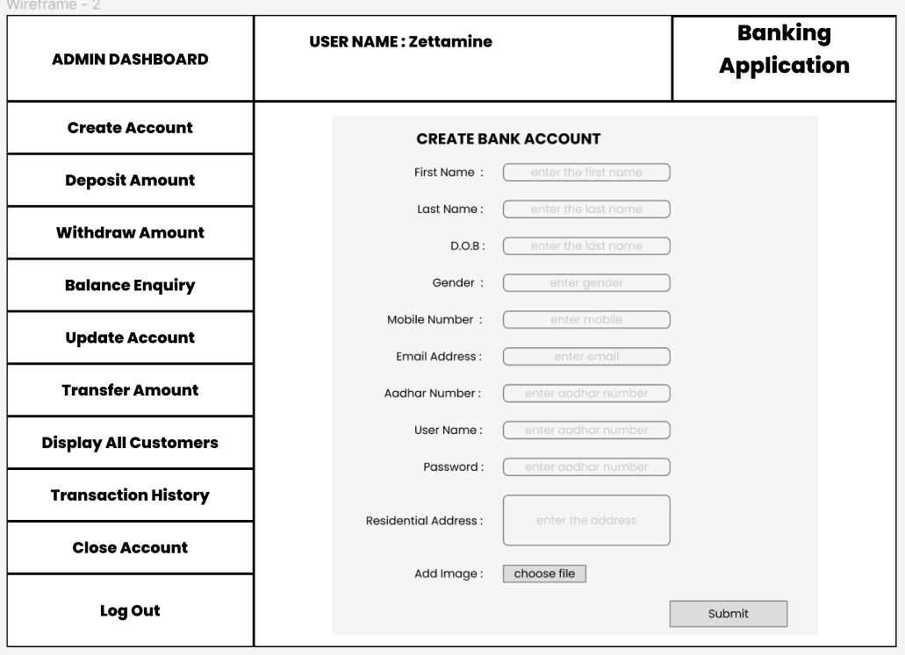
Presentation Layer-Create Account

Slide 5
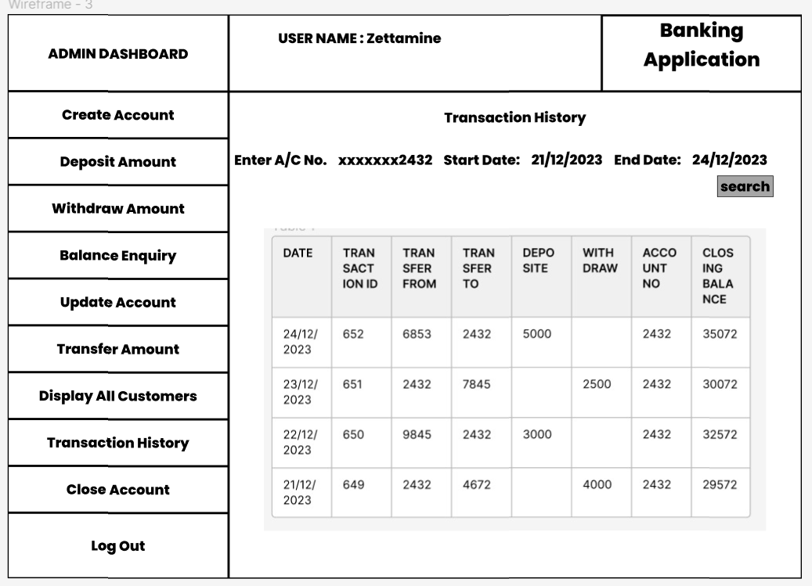
Presentation Layer-Transaction History

Slide 6
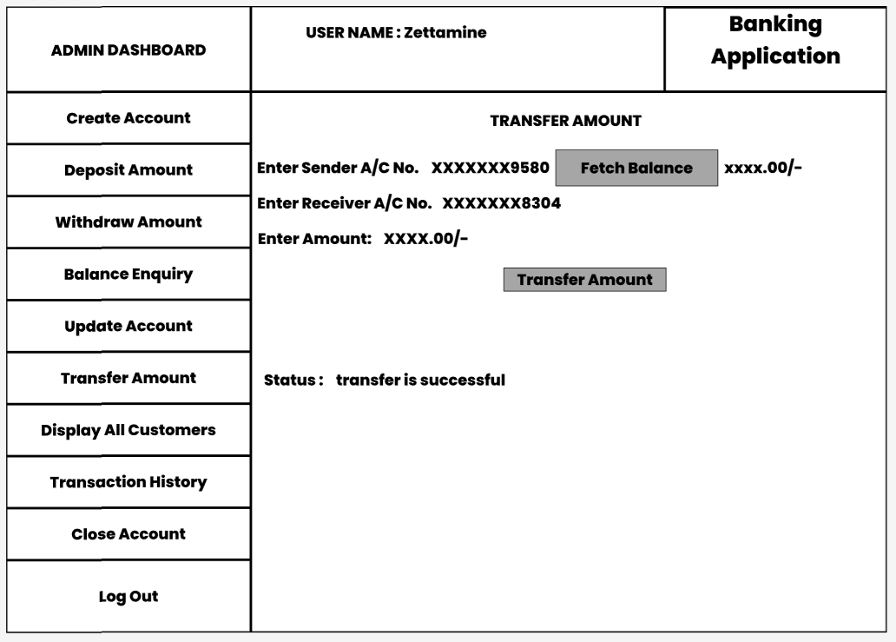
Presentation Layer-Transfer Amount

Slide 7
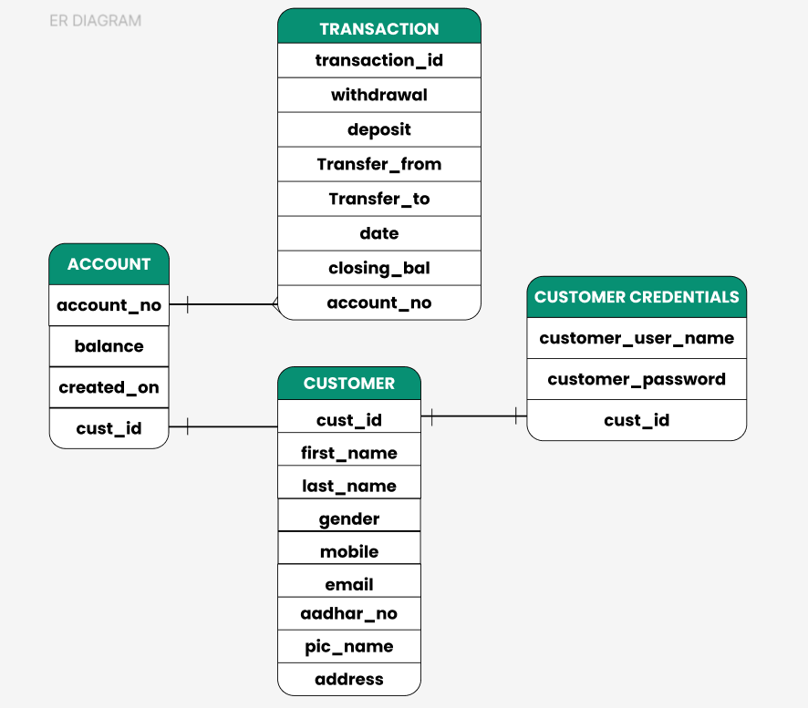
Database Table Diagrams

Slide 8
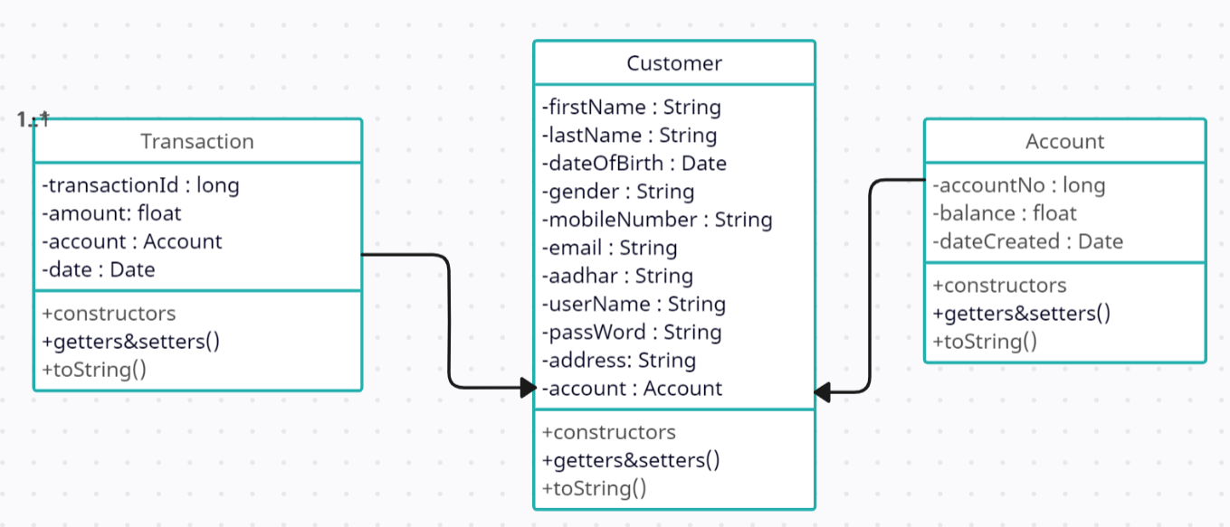
POJO Classes (UML)

